Slide 1
Welcome to Javascript

Slide 2
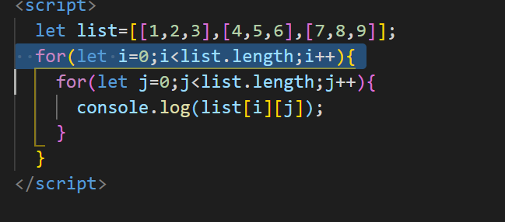
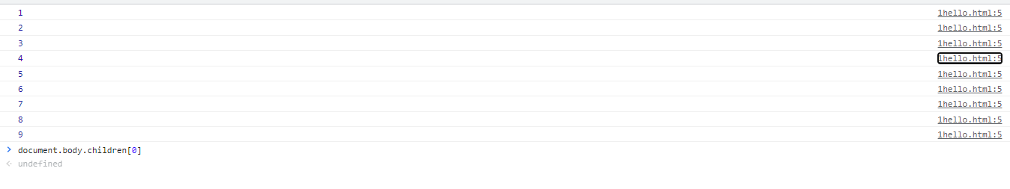
Two Dimension Array

Slide 3
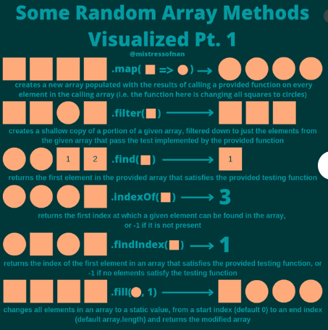
Other Arrays method

Slide 4
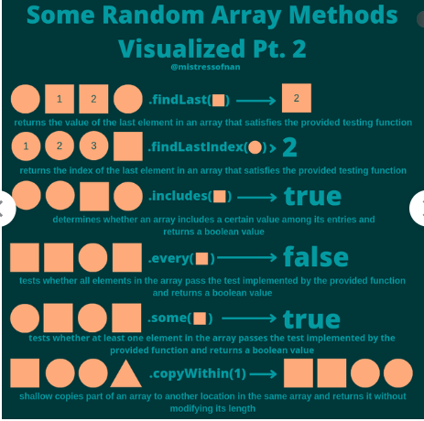
Other Arrays method

Slide 5
Other Arrays method

Slide 6
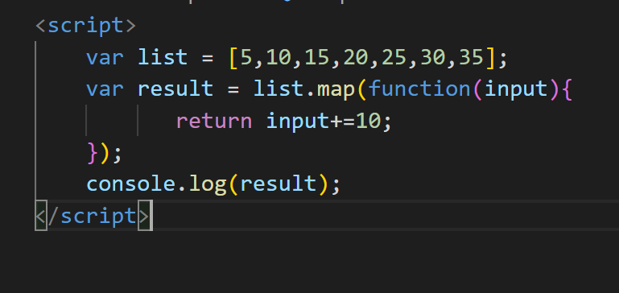

Map

Slide 7
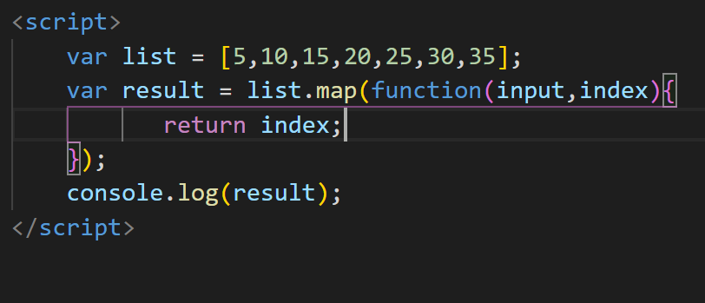

Map with index value

Slide 8
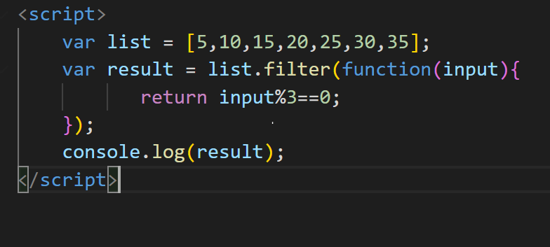

Filter

Slide 9
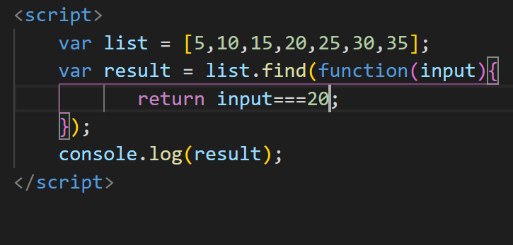

Find

Slide 10
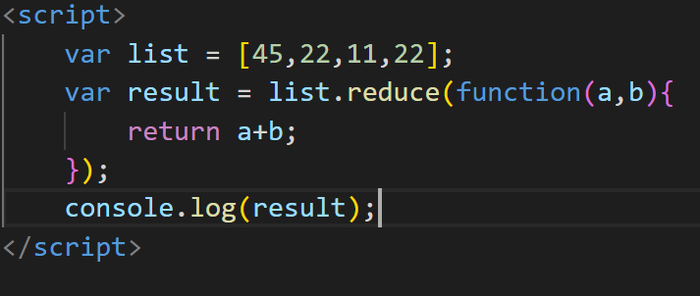
reduce

Slide 11
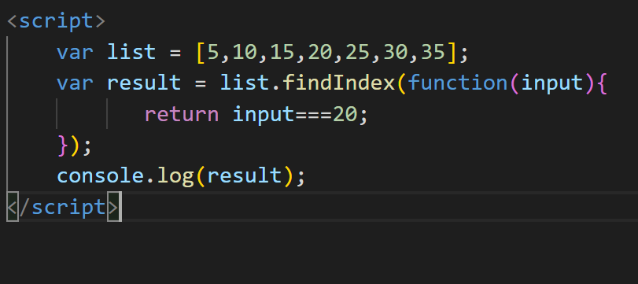
findIndex

Slide 12
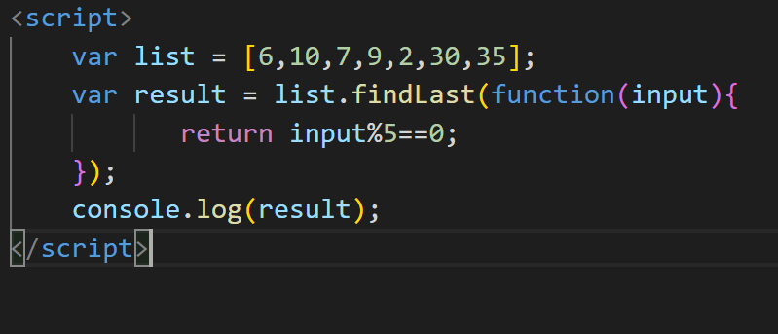
findLast

Slide 13
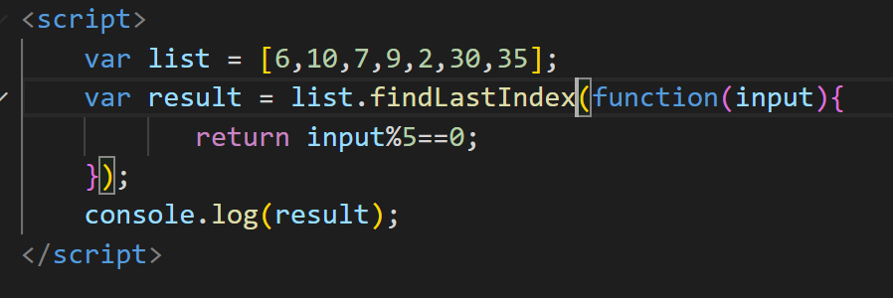
findLastIndex

Slide 14
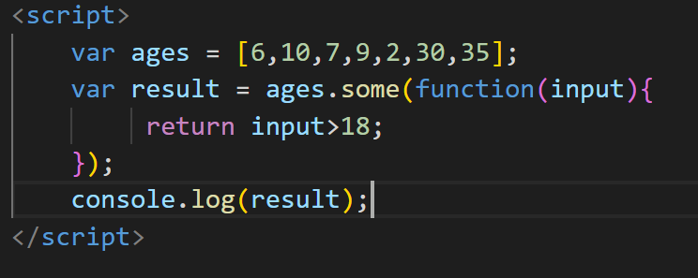

some

Slide 15
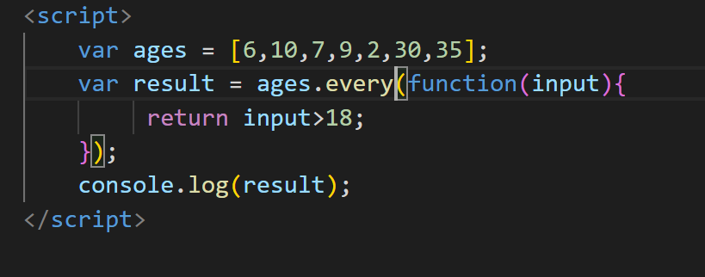

every

Slide 16
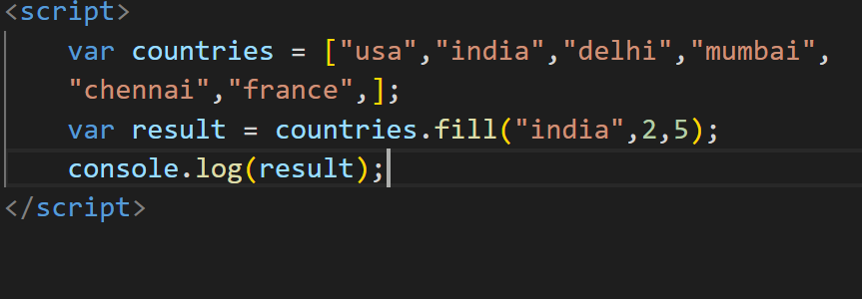
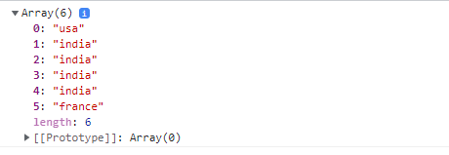
Fill

Slide 17
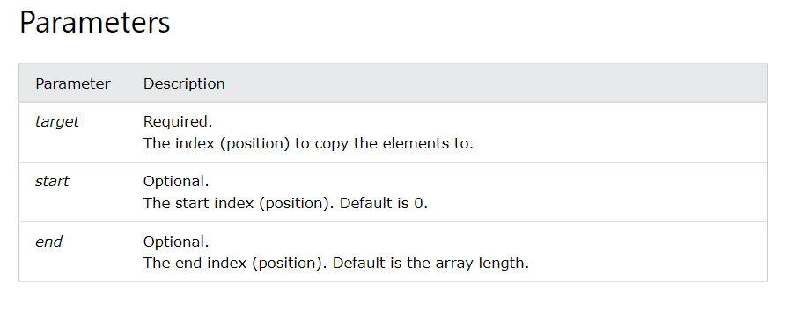
copywithin

Slide 18
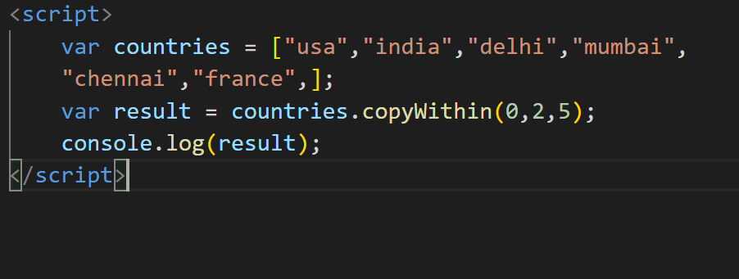
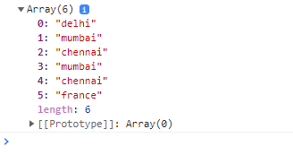
copywithin

Slide 19
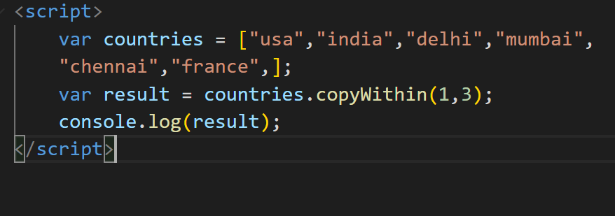

Copywithin

Slide 20
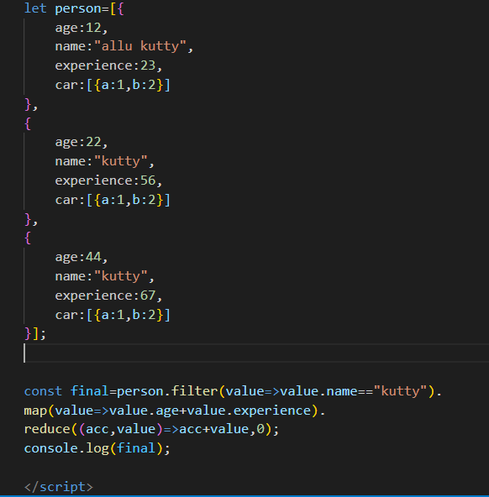
Map,Filter,Reduce

Slide 21
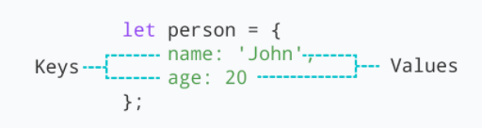
Object
JavaScript object is a non-primitive data-type that allows you to store multiple collections of data
Syntax:
const object_name = {
key1: value1,
key2: value2
}
// object creation
let person = {
name: 'John',
age: 20
};
console.log(typeof person); // object
"key: value" pairs are called properties

Slide 22
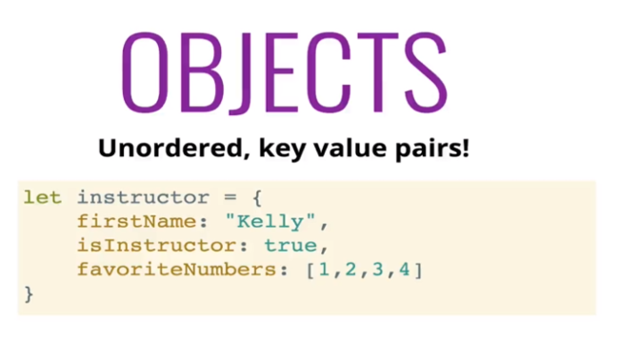
What is object

Slide 23
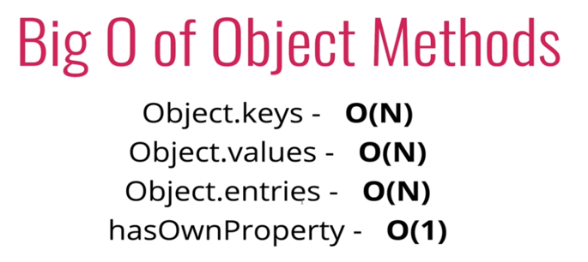
Time and space complexity

Slide 24
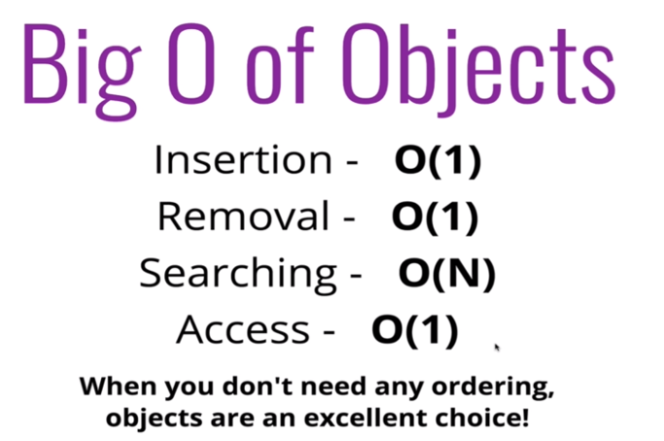
When to use it?

Slide 25
Object
Accessing Object Properties:
Syntax:
objectName.key
Or
objectName["propertyName"]
const person = {
name: 'John',
age: 20,
};
// accessing property
console.log(person.name); // John
const person = {
name: 'John',
age: 20,
};
// accessing property
console.log(person["name"]); // John

Slide 26
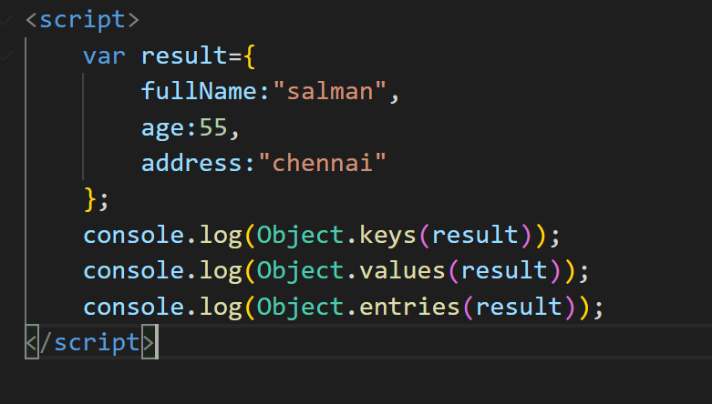
Object – for…in
Loop through an object Using for...in
const student = {
name: 'John',
age: 20,
hobbies: ['reading', 'games', 'coding'],
};
// using for...in
for (let key in student) {
let value;
// get the value
value = student[key];
console.log(key + " - " + value);
}

